Slide 1
Communications
Hospital incident command system
Incident Commander
Operations Chief
Planning Chief
Logistics Chief
Communications
Finance Chief

Slide 2
Procedures
Arrive at Emergency Operations Center
Check-in with the Logistics Chief
Deploy radio equipment
Monitor or assign other assets to monitor primary frequencies.
MARCS (Participating Hospital’s Talk group)
County (Hospital Primary talk group)
Ham (147.075 KHN, 147.195 MARA, ARES 146.640)

Slide 3
Tips
Keep volume levels low! Use earphones where practical.
Assign message scribe to keep track of incoming and outgoing messages.
Avoid “High Use” ham channels in EOC. Use outside operators to monitor and filter radio traffic from “High Use” Ham networks such as area wide ARES nets to help reduce noise.
Dress professionally.
Utilize standardized ICS traffic forms.

Slide 4
ICS-213 Message Form

Slide 5
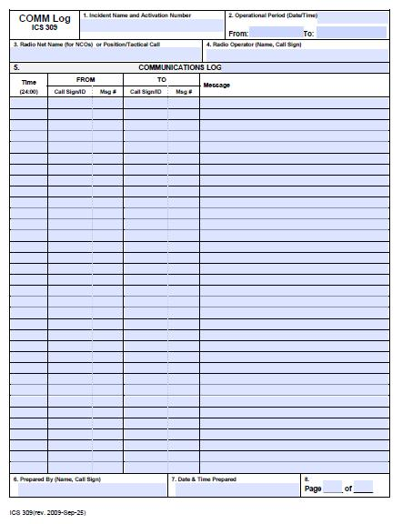
ICS 309Communications Log

Slide 6
Introduction to the
Ohio Multi Agency Radio Communications System (MARCS)

Slide 7
The MARCS System
800 MHz trunked, digital radio system
800 MHz is a frequency spectrum that offers very clear short range communications.
Digital means when you speak into the radio your voice is turned into to binary bits (1’s & 0’s) and sent out as a data stream.
Notes:
MARCS is an 800 MHz digital, trunked, state of the art communications system. Unlike conventional systems it is controlled entirely by a computer system linking all frequencies and tower sites in the system together.
There are 200 towers built across the state establishing the backbone of the system. These tower sites are linked by T-1 lines to the State of Ohio Computer Center in Columbus. Additionally each site has a generator in the event of power outages making the system almost disaster proof. This tower package runs between $750,000 and 1 Million dollars per site. Some equipment is on towers owned by others and in some cases the State has partnered with the local governments making the system more robust in those areas. In these cases both physical equipment and radio frequency pairs have been shared saving the taxpayers many dollars.

Slide 8
The System Continued
Backbone is a system of
214 towers across the state
T1 line from each tower site back to the Computer Center in Columbus
Emergency generator with enough fuel for three days.
Green, Montgomery and Preble are on one site located on the Ch. 16 tower.
Only 5 trunking channels with a 6th channel coming.
Notes:
The backbone of the system is a series of 200 towers across the state equipped with the frequency pairs for that area and a T-1 computer line back to Columbus to the computer center. These sites are supported by a generator in case of power outage. The generators are powered by propane or diesel. Fuel levels are monitored in Columbus.

Slide 9
Current users of MARCS
Ohio Hospitals
Ohio State Highway Patrol
Ohio Dept. of Natural Resources
Ohio Emergency Management Agency
Ohio Department of Health
Ohio Department of Transportation
Ohio Department of Corrections
Ohio Department of Youth Services
Ohio Department of Agriculture
Ohio State Fire Marshal
Notes:
These are the agencies that are now committed to the system. Most are are on line now.

Slide 10
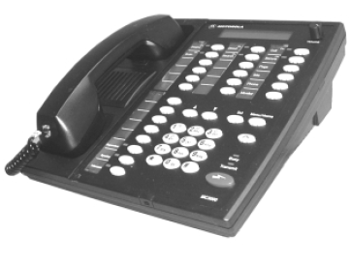
Let’s Talk Talkgroups
Think of the radio as a filing cabinet
It has 32 drawers, we call them Zones
In the drawers, or zones, there are up to 16 files Talkgroups
Talkgroups are not specific frequencies but are assigned differing frequencies from time to time
Everyone working on a particular file (event, situation) gets in that talkgroup
When you want to talk to someone not in your talkgroup, you go to their TG, or you can Private Call them
Notes:
Talk groups put people with similar interests together so that they can operate without interfering with others. This type of system allows us to have operations on the same system with Ohio State Highway Patrol, Combined operations with Agriculture, sustained operations during disasters with OEMA and local health and EMA officials.

Slide 11
Zones and Talkgroups
In the ODH plan, there are 19 zones
Each zone can have up to 16 talkgroups
We will study selected zones and talkgroups
Some zones and talkgroups are the same throughout the state (i.e. Zones 8-19 are Hospital Talkgroups)
Notes:
Public Health in Ohio has not had radio communications in recent history. The involvement in the MARCS project guarantees us statewide coverage. The talk groups that have been developed for these radios reflect how we need to function in the day to day operations and how we need to function during a crises. We have full interoperability with other state agencies and some local agencies, depending on how they have set up their radios.

Slide 12
Radio Configurations
All Hospital radios are programmed with a similar scheme, with slight variations for each county.
When Local Hospital talkgroups within the county appear in Zone 1.
Zone 1 also includes:
Local Health Department(s)
County Sheriff (SO)
Notes:
All radios housed at ODH are programmed the same and all Local HD radios are programmed the same. For locals this includes Zone 1 which has all local existing talk groups including the local health department, hospitals and sheriff’s departments. In cases where locals have existing 800 MHz talkgroups they show up here or in a separate zone at the end, usually zone 27.

Slide 13
Local Zone 1
Zone 1
HOS-5704
MNTGMRY
HOS-5701
HOS-5702
HOS-5703
HOS-5705
HOS-5706
HOS-5707
HOS-5708
EMA-COSW
SO-57
M Call 1
M Comm 1
ODH-Call
Zone 1 – Local Talkgroups
Most of your communication will take place in Zone 1.
Zone 1 includes local health department(s) and Sheriff offices

Slide 14
Local Zone 1
Zone 1
5704 Kettering Hosp
Montgomery Health
5701 Dayton Heart Hosp
5702 Good Sam Hosp
5703 Grandview Hosp
5705 Miami Valley Hosp
5706 Southview Hosp
5707 Sycamore Hosp
5708 Children’s Hosp
EMA - COSW
Montgomery Sheriff
M Call 1
M Comm 1
OH Dept Health-CALL
Zone 1 – Local Talkgroups
Most of your communication will take place in Zone 1.
Zone 1 includes local health department(s) and Sheriff offices

Slide 15
Local Zone 2
Zone 2 contains Regional Talkgroups
Includes the Sheriff’s Office, and Help
Zone 2
LHD-WCEN
HOS-WCEN
SO-SW
HOS-SW
HOS-CEN
VAHOSPS
WPAFB
HOS-ALL
HLTH-ALL
HELPDESK

Slide 16
Local Zones 3-5
Incident Command Sets (matches HEICS plan)
Zone 3 is the Local Health Department Command Set
Zone 4 & 5 are ODH Command Sets
Allows for communication in multiple events
Zone 3 | Zone 4 | Zone 5
LHCOMM1 | ECOMM07 | ECOMM23
LHCOMM2 | ECOMM08 | ECOMM24
LHCOMM3 | ECOMM09 | ECOMM25
LHCOMM4 | ECOMM10 | ECOMM26
LHCOMM5 | ECOMM11 | ECOMM27
LHCOMM6 | ECOMM12 | ECOMM28
LHCOMM7 | ECOMM13
LHCOMM8 | ECOMM14
LECOMM1 | ECOMM15
LECOMM2 | ECOMM16
LECOMM3 | ECOMM17
LECOMM4 | ECOMM18
 | ECOMM19
 | ECOMM20
 | ECOMM21
 | ECOMM22

Slide 17
Zones 6-19
Zone 6 – SCALL groups
Zone 7 – Interoperability and Talk-Around
Note! If you are on this zone, no one will be able to Select CALL you with your code!
This is because you will not be using the trunking system and are operating point to point at short distances.
Zone 8 to 19 –State-wide individual hospital talkgroups

Slide 18
Zones 1 to 7
Zone 1 | Zone 2 | Zone 3 | Zone 4 | Zone 5 | Zone 6 | Zone 7
HOS-5704 | LHD-WCEN | LHCOMM1 | ECOMM07 | ECOMM23 | SCALL | 8 ICALL
MNTGOMRY | HOS-WCEN | LHCOMM2 | ECOMM08 | ECOMM24 | SCOMM01 | 8 ITAC1
HOS-5701 | SO-SW | LHCOMM3 | ECOMM09 | ECOMM25 | SCOMM02 | 8 ITAC2
HOS-5702 | HOS-SW | LHCOMM4 | ECOMM10 | ECOMM26 | SCOMM03 | 8 ITAC3
HOS-5703 | HOS-CEN | LHCOMM5 | ECOMM11 | ECOMM27 | SCOMM04 | 8 ITAC4
HOS-5705 | VAHOSPS | LHCOMM6 | ECOMM12 | ECOMM28 | SCOMM05 | 8ICALLTA
HOS-5706 | WPAFB | LHCOMM7 | ECOMM13 |  | SCOMM06 | 8ITAC1TA
HOS-5707 | HOS-ALL | LHCOMM8 | ECOMM14 |  | SCOMM07 | 8ITAC2TA
HOS-5708 | HLTH-ALL | LECOMM1 | ECOMM15 |  | SCOMM08 | 8ITAC3TA
EMA-COSW | HELPDESK | LECOMM2 | ECOMM16 |  | SCOMM09 | 8ITAC4TA
SO-57 |  | LECOMM3 | ECOMM17 |  | SCOMM10 | TA-1
M Call 1 |  | LECOMM4 | ECOMM18 |  | SCOMM11 | TA-2
M Comm 1 |  |  | ECOMM19 |  | SCOMM12 | TA-3
ODH-CALL |  |  | ECOMM20
 |  |  | ECOMM21
 |  |  | ECOMM22

Slide 19
Zone 8 to 19
Complete list of Hospital Zones
Zone 8 | Zone 9 | Zone 10 | Zone 11 | Zone 12 | Zone 13 | Zone 14 | Zone 15 | Zone 16 | Zone 17 | Zone 18 | Zone 19
HOS-0101 | HOS-0901 | HOS-1803 | HOS-1901 | HOS-2511 | HOS-3109 | HOS-4201 | HOS-4807 | HOS-5704 | HOS-7201 | HOS-7705 | HOS-8801
HOS-0201 | HOS-0902 | HOS-1804 | HOS-2001 | HOS-2512 | HOS-3110 | HOS-4301 | HOS-4808 | HOS-5705 | HOS-7202 | HOS-7706
HOS-0202 | HOS-0903 | HOS-1805 | HOS-2002 | HOS-2601 | HOS-3111 | HOS-4302 | HOS-4901 | HOS-5706 | HOS-7203 | HOS-7801
HOS-0203 | HOS-0904 | HOS-1806 | HOS-2003 | HOS-2602 | HOS-3201 | HOS-4501 | HOS-5001 | HOS-5707 | HOS-7301 | HOS-7802
HOS-0301 | HOS-1101 | HOS-1807 | HOS-2101 | HOS-2701 | HOS-3301 | HOS-4601 | HOS-5002 | HOS-5708 | HOS-7401 | HOS-7901
HOS-0401 | HOS-1201 | HOS-1808 | HOS-2201 | HOS-2801 | HOS-3401 | HOS-4701 | HOS-5003 | HOS-5901 | HOS-7402 | HOS-7902
HOS-0402 | HOS-1202 | HOS-1809 | HOS-2301 | HOS-2901 | HOS-3501 | HOS-4702 | HOS-5004 | HOS-6001 | HOS-7501 | HOS-8001
HOS-0403 | HOS-1301 | HOS-1810 | HOS-2401 | HOS-3001 | HOS-3601 | HOS-4703 | HOS-5101 | HOS-6002 | HOS-7601 | HOS-8101
HOS-0404 | HOS-1401 | HOS-1811 | HOS-2501 | HOS-3101 | HOS-3602 | HOS-4704 | HOS-5201 | HOS-6201 | HOS-7602 | HOS-8301
HOS-0501 | HOS-1501 | HOS-1812 | HOS-2502 | HOS-3102 | HOS-3701 | HOS-4705 | HOS-5202 | HOS-6301 | HOS-7603 | HOS-8401
HOS-0502 | HOS-1502 | HOS-1813 | HOS-2503 | HOS-3103 | HOS-3801 | HOS-4801 | HOS-5203 | HOS-6501 | HOS-7604 | HOS-8402
HOS-0601 | HOS-1601 | HOS-1814 | HOS-2504 | HOS-3104 | HOS-3901 | HOS-4802 | HOS-5401 | HOS-6601 | HOS-7605 | HOS-8501
HOS-0701 | HOS-1701 | HOS-1816 | HOS-2507 | HOS-3105 | HOS-3902 | HOS-4803 | HOS-5501 | HOS-6701 | HOS-7701 | HOS-8502
HOS-0702 | HOS-1703 | HOS-1817 | HOS-2508 | HOS-3106 | HOS-4001 | HOS-4804 | HOS-5701 | HOS-7001 | HOS-7702 | HOS-8601
HOS-0703 | HOS-1801 | HOS-1820 | HOS-2509 | HOS-3107 | HOS-4101 | HOS-4805 | HOS-5702 | HOS-7002 | HOS-7703 | HOS-8602
HOS-0801 | HOS-1802 | HOS-1821 | HOS-2510 | HOS-3108 | HOS-4102 | HOS-4806 | HOS-5703 | HOS-7101 | HOS-7704 | HOS-8701

Slide 20
County ID Numbers
01 Adams | 19 Darke | 37 Hocking | 55 Miami | 73 Scioto
02 Allen | 20 Defiance | 38 Holmes | 56 Monroe | 74 Seneca
03 Ashland | 21 Delaware | 39 Huron | 57 Montgomery | 75 Shelby
04 Ashtabula | 22 Erie | 40 Jackson | 58 Morgan | 76 Stark
05 Athens | 23 Fairfield | 41 Jefferson | 59 Morrow | 77 Summit
06 Auglaize | 24 Fayette | 42 Knox | 60 Muskingum | 78 Trumbull
07 Belmont | 25 Franklin | 43 Lake | 61 Noble | 79 Tuscarawas
08 Brown | 26 Fulton | 44 Lawrence | 62 Ottawa | 80 Union
09 Butler | 27 Gallia | 45 Licking | 63 Paulding | 81 Van Wert
10 Carroll | 28 Geauga | 46 Logan | 64 Perry | 82 Vinton
11 Champaign | 29 Greene | 47 Lorain | 65 Pickaway | 83 Warren
12 Clark | 30 Guernsey | 48 Lucas | 66 Pike | 84 Washington
13 Clermont | 31 Hamilton | 49 Madison | 67 Portage | 85 Wayne
14 Clinton | 32 Hancock | 50 Mahoning | 68 Preble | 86 Williams
15 Columbiana | 33 Hardin | 51 Marion | 69 Putnam | 87 Wood
16 Coshocton | 34 Harrison | 52 Medina | 70 Richland | 88 Wyandot
17 Crawford | 35 Henry | 53 Meigs | 71 Ross
18 Cuyahoga | 36 Highland | 54 Mercer | 72 Sandusky

Slide 21
Hospital Talk Groups
TALKGROUP Hospital Name
HOS-0101 Adams County Hospital
HOS-0201 St. Rita's Medical Center
HOS-0202 Lima Memorial Health System
HOS-0203 Blanchard Valley Regional Health Center -- Bluffton Campus
HOS-0301 Samaritan Regional Health Systems
HOS-0401 Ashtabula County Medical Center
HOS-0402 UHHS Brown Memorial Hospital
HOS-0403 UHHS Memorial Hospital of Geneva
HOS-0501 Doctors Hospital of Nelsonville
HOS-0502 O'Bleness Memorial Hospital
HOS-0601 Joint Township District Memorial Hospital
HOS-0701 Barnesville Hospital
HOS-0702 Belmont Community Hospital
HOS-0703 East Ohio Regional Hospital
HOS-0801 Brown County General Hospital
HOS-0901 McCullough-Hyde Memorial Hospital
HOS-0902 Mercy Hospital of Fairfield
HOS-0903 Middletown Regional Hospital
HOS-0904 Fort Hamilton Hospital
HOS-1101 Mercy Memorial Hospital
HOS-1201 The Community Hospital of Springfield
HOS-1202 Mercy Medical Center Springfield
HOS-1301 Mercy Hospital Clermont
HOS-1401 Clinton Memorial Hospital
HOS-1501 East Liverpool City Hospital
HOS-1502 Salem Community Hospital
HOS-1601 Coshocton County Memorial Hospital
HOS-1701 Bucyrus Community Hospital
HOS-1703 Galion Community Hospital
HOS-1801 Cleveland Clinic Foundation
HOS-1802 Euclid Hospital CCHS
HOS-1803 Fairview Hospital CCHS
HOS-1804 CCF Children's Hospital for Rehabilitation
HOS-1805 Hillcrest Hospital CCHS
HOS-1806 Huron Hospital CCHS
HOS-1807 Lakewood Hospital CCHS
HOS-1808 Lutheran Hospital CCHS
HOS-1809 Marymount Hospital CCHS
HOS-1810 MetroHealth Medical Center
HOS-1811 South Pointe Hospital CHHS
HOS-1812 Southwest General Health Center
HOS-1813 St. John West Shore Hospital
HOS-1814 St. Vincent Charity Hospital
HOS-1816 UHHS Bedford Medical Center
HOS-1817 University Hospitals of Cleveland
HOS-1820 Parma Community Hospital
HOS-1821 UHHS Richmond Heights Hospital
HOS-1901 Wayne Hospital
HOS-2001 Community Memorial Hospital
HOS-2002 Defiance Regional Medical Center
HOS-2003 Mercy of Defiance
HOS-2101 Grady Memorial Hospital
HOS-2201 Firelands Regional Medical Center
HOS-2301 Fairfield Medical Center
HOS-2401 Fayette County Memorial Hospital
HOS-2501 Nationwide Children's Hospital
HOS-2502 Dublin Methodist Hospital
HOS-2503 Doctors Hospital West
HOS-2504 Grant Medical Center
HOS-2507 Mount Carmel East Hospital
HOS-2507 Mount Carmel New Albany Hospital
HOS-2508 Mount Carmel St. Ann's Hospital
HOS-2509 Mount Carmel West Hospital
HOS-2510 Riverside Methodist Hospital
HOS-2511 Ohio State University Medical Center
HOS-2512 Ohio State University Hospital East
HOS-2601 Fulton County Health Center
HOS-2602 Community Hospital Williams County Archbold Campus
HOS-2701 Holzer Medical Center
HOS-2801 UHHS Geauga Regional Hospital
HOS-2901 Greene Memorial Hospital
HOS-3001 Southeastern OH Regional Medical Center
HOS-3101 Bethesda North Hospital
HOS-3102 Cincinnati Children's Hospital
HOS-3103 Deaconess Hospital

Slide 22
Hospital Talk Groups (Cont)
HOS-3104 Good Samaritan Hospital
HOS-3105 Mercy Franciscan Hospital Mt. Airy
HOS-3106 Mercy Franciscan Hospital Western Hills
HOS-3107 Mercy Hospital Anderson
HOS-3108 The Christ Hospital
HOS-3109 The Jewish Hospital (Kenwood)
HOS-3110 The University Hospital
HOS-3111 Mercy Harrison 24 Hour Care
HOS-3201 Blanchard Vlly Regional Health Ctr--Findlay
HOS-3301 Hardin Memorial Hospital
HOS-3401 Harrison Community Hospital
HOS-3501 Henry County Hospital
HOS-3601 Greenfield Area Medical Center
HOS-3602 Highland District Hospital
HOS-3701 Hocking Valley Community Hospital
HOS-3801 Pomerene Hospital
HOS-3901 Fisher-Titus Medical Center
HOS-3902 Mercy Hospital of Willard
HOS-4001 Holzer Medical Center -- Jackson
HOS-4101 Trinity Medical Center East
HOS-4102 Trinity Medical Center West
HOS-4201 Knox Community Hospital
HOS-4301 Lake East Hospital
HOS-4302 Lake West Hospital
HOS-4501 Licking Memorial Health Systems
HOS-4601 Mary Rutan Hospital
HOS-4701 EMH Regional Medical Center
HOS-4702 Community Health Partners
HOS-4703 Amherst Hospital
HOS-4704 Allen Medical Center
HOS-4705 Avon Emergency Care Center
HOS-4801 Flower Hospital
HOS-4802 University of Toledo Health Science Campus
HOS-4803 St. Charles Mercy Hospital
HOS-4804 St. Luke's Hospital
HOS-4805 St. Vincent Mercy Medical Center
HOS-4806 Toledo Hospital
HOS-4807 St. Anne Mercy Medical Hospital
HOS-4808 Bay Park Community Hospital
HOS-4901 Madison County Hospital
HOS-5001 St. Elizabeth Medical Center
HOS-5002 Northside Medical Center
HOS-5003 Tod's Children's Hospital
HOS-5004 St Elizabeth Health Center
HOS-5101 Marion General Hospital
HOS-5201 Medina General Hospital
HOS-5202 Wadsworth-Rittman Hospital
HOS-5203 Lodi Community Hospital
HOS-5401 Mercer Health
HOS-5501 Upper Valley Medical Center
HOS-5701 Dayton Heart Hospital
HOS-5702 Good Samaritan Hospital and Health Center
HOS-5703 Grandview Hospital or Medical Center
HOS-5704 Kettering Medical Center
HOS-5705 Miami Valley Hospital
HOS-5706 Southview Hospital and Family Health Center
HOS-5707 Sycamore Hospital
HOS-5708 The Children's Medical Center
HOS-5901 Morrow County Hospital
HOS-6001 Genesis Healthcare Sys -- Bethesda Hospital
HOS-6002 Genesis Health Care Sys -- Good Samaritan Hospital
HOS-6201 H. B. Magruder Memorial Hospital
HOS-6301 Paulding County Hospital
HOS-6501 Berger Health System
HOS-6601 Pike Community Hospital
HOS-6701 Robinson Memorial Hospital
HOS-7001 Med Central Health System -- Shelby Hospital
HOS-7002 MedCentral Health System -- Mansfield Hospital - ED
HOS-7002 MedCentral Health System -- Mansfield Hospital - Command
HOS-7101 Adena Health System
HOS-7201 Memorial Hospital
HOS-7202 St. Francis Health Care Center
HOS-7203 The Bellevue Hospital
HOS-7301 Southern Ohio Medical Center Emergency Services
HOS-7401 Mercy Hospital of Tiffin
HOS-7402 Fostoria Community Hospital
HOS-7501 Wilson Memorial Hospital
HOS-7601 Aultman Health Foundation

Slide 23
Hospital Talk Groups (Cont)
HOS-7602 Alliance Community Hospital
HOS-7603 Affinity Medical Center Doctors Campus
HOS-7604 Mercy Medical Center
HOS-7605 Affinity Medical Center Massillon Campus
HOS-7701 Akron General Medical Center
HOS-7702 Akron Children's Hospital
HOS-7703 Cuyahoga Falls General Hospital
HOS-7704 Summa Health System -- St. Thomas Hospital
HOS-7705 Summa Health System -- Akron City Hospital
HOS-7706 Barberton Citizens Hospital
HOS-7801 St. Joseph Health Center
HOS-7802 Trumbull Memorial Hospital
HOS-7901 Twin City Hospital
HOS-7902 Union Hospital
HOS-8001 Memorial Hospital of Union County
HOS-8101 Van Wert County Hospital
HOS-8301 Bethesda Arrow Springs
HOS-8401 Marietta Memorial Hospital
HOS-8402 Selby General Hospital
HOS-8501 Dunlap Memorial Hospital
HOS-8502 Wooster Community Hospital
HOS-8601 Community Hospital Willaims County -- Bryan Campus
HOS-8602 Community Hospital Willaims County -- Montpelier Campus
HOS-8701 Wood County Hospital
HOS-8801 Wyandot Memorial Hospital

Slide 24
Common Terms
Affirmative = Yes Negative = No
Standby = used when the person must go find information.
Go Ahead or OVER= used at the end of a transmission indicating the other person should respond.
Clear or OUT = Used when all radio traffic is complete, usually with the persons designation i.e.: ODH 1 Clear or Command Clear.
Message Received = Also used to end a transmission
Break = Gives the listener time to write down info being transmitted
Say Again or Repeat = Used to ask for the last transmission to be repeated
Copy = Did you understand the last transmission?
MAYDAY = Universal call for help.
In critical transmissions it is usually good to repeat the last traffic.
In general use, when you know you have access to a dispatch center simply saying “xxxxxx county dispatch, I have emergency traffic” will suffice.
Notes:
These are common terms used on the radio in most services. They have come to be used over the years because they are the easiest to understand.

Slide 25
Desktop Controller
LCD Display
Volume Control
Radio Function Buttons
Home Button
LED Indicators
Transmit Button
Zone Up/Down Button
Handset
Call Button
Internal Speaker
Talk group
Selection Buttons
Speaker Button
Intercom Button
ZnDwn
Call
Notes:
This slide is self explanatory.

Slide 26
Zones
Changing Zones:
Depress the zone up or down buttons to select the zone.
If you pass the zone you wish to choose, pressing Home will take you back to Zone 1, and your local hospital TG.
Notes:
Each high tier radio contains 32 zones with 16 talkgroups available in each zone. The left white oval button is the zone button and corresponds to the word appearing above it. At this time depress the zone button and then 1. You are now on zone 1, TG 1 or the HAILING channel. This will be used to call people when it is unknown what talk group they are monitoring and should be included in your scan list which will be explained later.

Slide 27
Talk Groups
Changing Talk Groups:
The Talk Group name will show in the main display.
You may go up or down in a zone through the 16 talk groups by using the up and down buttons.
Notes:
Each high tier radio contains 32 zones with 16 talkgroups available in each zone. The left white oval button is the zone button and corresponds to the word appearing above it. At this time depress the zone button and then 1. You are now on zone 1, TG 1 or the HAILING channel. This will be used to call people when it is unknown what talk group they are monitoring and should be included in your scan list which will be explained later.

Slide 28
Radio Identifier
Each radio has a unique 6 digit identifier.
To find the ID number of your radio:
Depress the CALL button.
Press the talkgroup selection down (↓)button
My ID will appear in the display box.
Write this number down.
Return to HOS-WCEN
ZnUP
ZnDwn
Call
Notes:
The center white button with two dots corresponds to the word call. Write down your radio number here_____________________. It should be a 6 digit starting with 710xxx

Slide 29
Private Calling
Initiating a Private Call:
Press the CALL button.
Key in the number of the radio you wish to call.
Press the Push-To-Talk button
You will hear a ringing sound.
The radio you are calling will beep.
Receiving a Private Call:
Press the CALL button.
Press the Push-To-Talk button and say, “This is xxx hospital, Go Ahead.”
Disconnect from Private Call by touching the HOME button when finished to free up frequency pairs.
The person initiating the call is responsible for reminding the person they’ve called to disconnect (including how to disconnect).
Notes:
Divide the class into A’s and B’s. All A’s, determine your neighbors number. At this time we will call our neighbors. Press the call button, key in your neighbors number, press the PTT button. You will hear a ringing sound, they will hear a double beep. For the called party to answer, depress the call button and then the PTT button and say “GO AHEAD”.

Slide 30
Normal Radio Use
Normal Daily Routine
Make sure that all radios are set to your Home talkgroup (i.e., Zone 1, Talkgroup 1), most of the time. For emergencies that involve multiple West Central Ohio Counties, then use scanning, and include the following talkgroup:
West Central region HOS-WCEN talkgroup
E.g. Zone 2, HOS-WCEN
If you depress the Push-to-Talk button, you will hear a series of chirps.
This is saying to you “it’s OK to talk”

Slide 31
Scanning
You can program your radio to scan up to 10 talkgroups at a time.
Recommended talkgroups to scan:
West Central hospitals hailing – Zone 2: HOS-WCEN
Your own hospital’s talkgroup
Local Health Department talkgroup
Local Health Department WCEN talkgroup
Talkgroups #5 – 10 are up to you.
You should keep your radio set to your hospital’s talkgroup (i.e., Talkgroup #1, Zone 1), unless there is an area-wide emergency.
Note: Some radios do not permit scanning.

Slide 32
Scanning
To program Scan
Find the TG you wish to scan
Press and hold the Scan button until the scan indicator light blinks
Push the SEL button to select that TG
Proceed with the next channel by starting again with Step 1 through 3
Press the Scan or HOME button to exit scan list programming and return to normal scan operation (solid scan indicator light on display)
32
Notes:
32

Slide 33
Who to Call for Assistance
If you have radio problems or need assistance using the radio, try one of the following:
Zone 2 – HELPDESK talkgroup. This is the MARCS office in Columbus
Helpdesk Phone Number – 866-646-2727 (866-OHMARCS)
You can also contact one of the ODH Trainers for this region as listed below:
Doug Magilvy | MVH | 208-2151 | dbmagilvy@mvh.org
Brian Kuntz | KMC | 298-3399 x 55773 | brian.kuntz@khnetwork.org
John Larch | CMC | 641-5600 | larchj@childrensdayton.org
Bill White | KMC | 395-8804 | bill.white@khnetwork.org

Slide 34
Alinco DR-605

Slide 35
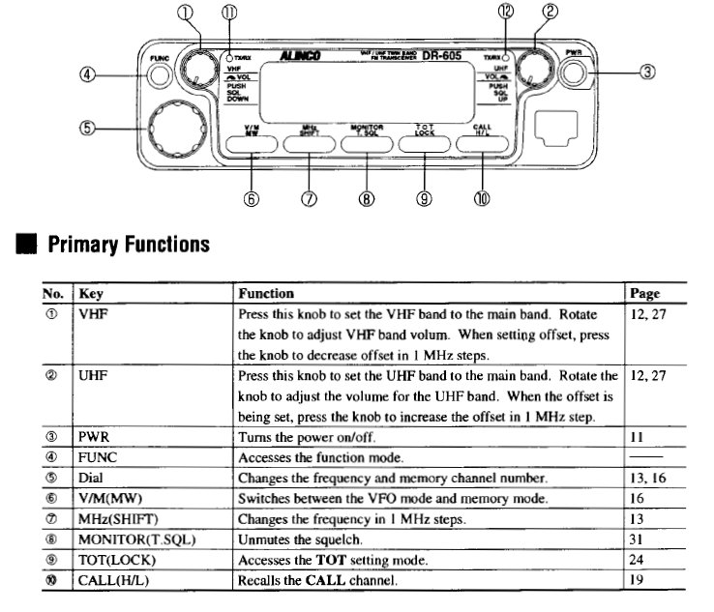

Slide 36
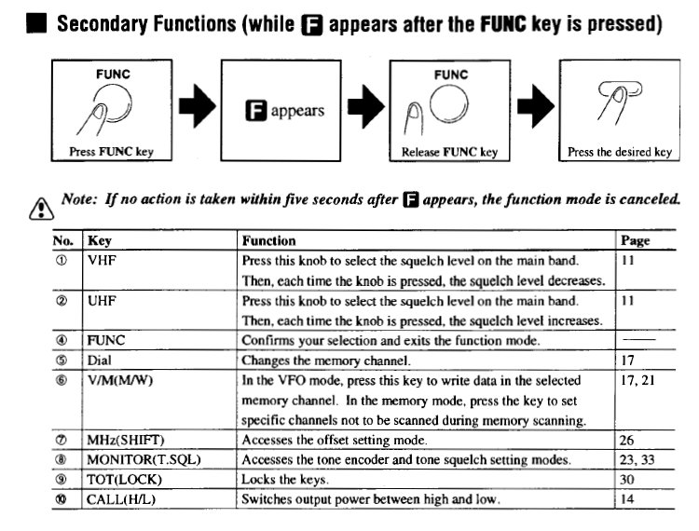

Slide 38
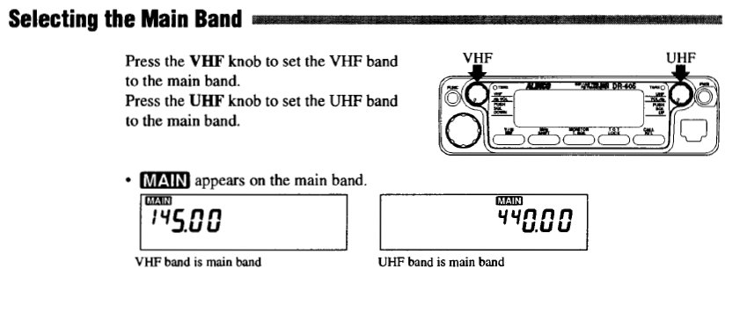

Slide 39
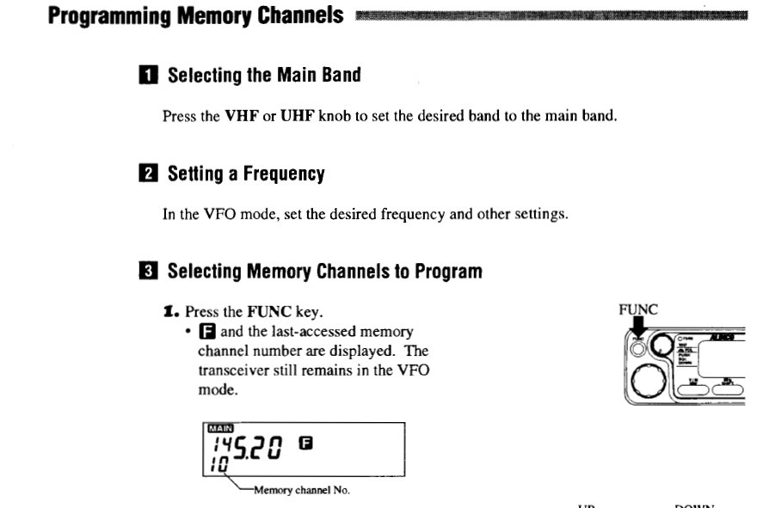

Slide 40
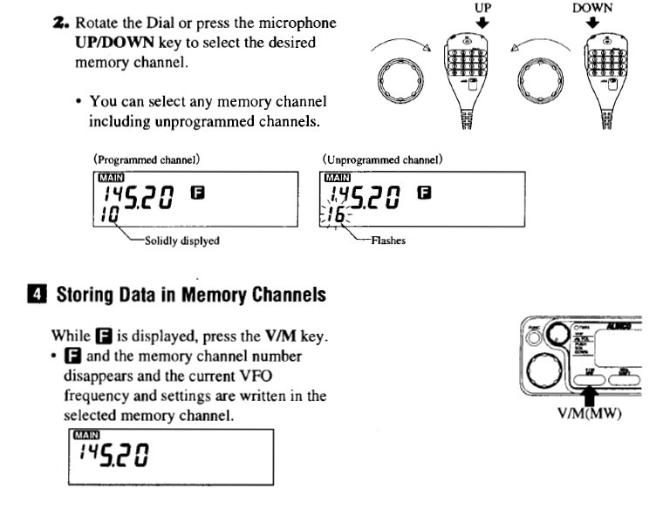

Slide 41
Alinco Notes
You must also turn the power supply on.

Slide 42
Online pdf for the ALINCO DR-605 or DR-635 manuals
http://www.alinco.com/pdf.files/

Slide 43
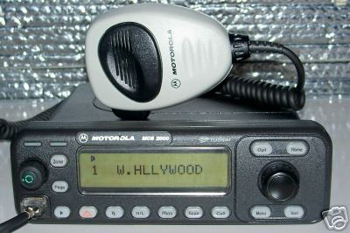
Motorola MCS-2000
Power / Volume
Change Talkgroups

Slide 44
MCS 2000 Notes
Push the Volume button to turn on
There are only two talkgroups loaded
HOSP PRI (Montgomery County trunking system)
HOSP SEC (Dayton City trunking system)
The power supply must also be turned on.

Slide 45
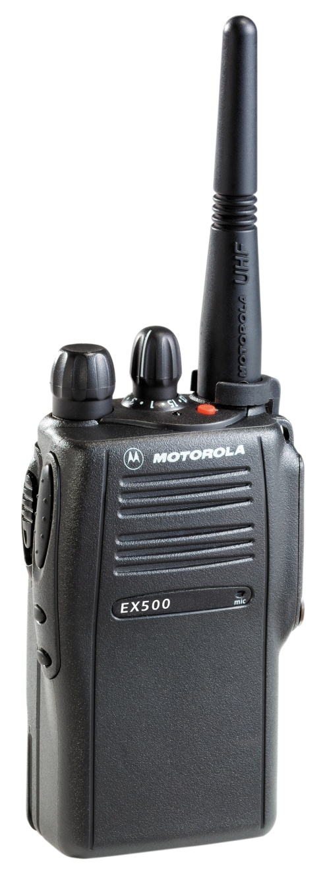
Motorola EX-500
You should keep a checkout list
Show user how to use radio
Use Channel 1

Slide 46
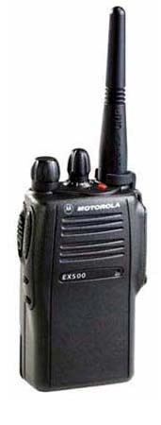
Motorola EX-500 Hand-Held Radio
Standard Radio Protocol
Check your radio “Out” and “In” at the command center communications section.
When transmitting, wait one second after pushing the Push-To-Talk (PTT) button before speaking. This will allow repeater circuits to stabilize.
Know your “Tactical Call” by which others will call you, i.e. “Transport 3”.
When calling, use the format: (“Their Call”, “Their Call” this is “My Call” calling). As an example: “Dispatch, Dispatch, this is Move Team 3 calling”.
Use Channel 1.
Do not use patient names.
Remember, this radio is not encrypted so others can monitor your transmissions outside the hospital.
Use professional language.
Use plain English – no Codes like 10-4, etc.
Keep transmissions short.
Wait for a response to your call before continuing on.
Channel Control
Power and
Volume Control
PTT Button

